Slide 1
WEB Technologies

Slide 2
What is a WEBSITE?

Slide 3
What is a WEB Page?

Slide 4
Web Page contains?

Slide 5
HTML

Slide 6
What is HTML?
HTML stands for Hyper Text Markup Language
HTML is the standard markup language for creating Web pages
HTML describes the structure of a Web page
HTML consists of a series of elements
HTML elements tell the browser how to display the content

Slide 7
What is the Structure of
HTML?

Slide 8
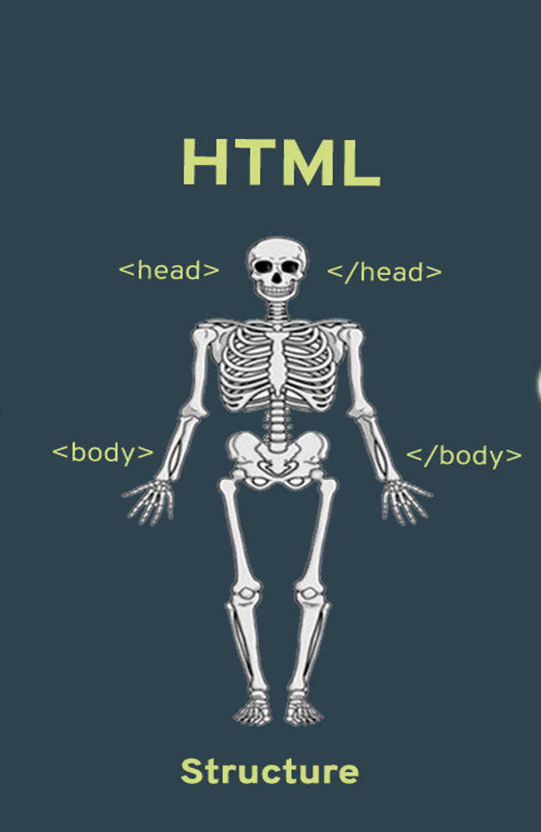

Slide 9
Basic Structure
<!Doctype html>
<html>
<head>
<title> HTML structure</title>
</head> <body>
- - - - - - - - - - - - - -
- - - - - - - - - - - - -
</body>
</html>

Slide 10
Head Tag
Heading 1
Heading 2
Heading 3
Heading 4
Heading 5
Heading 6

Slide 11
Paragraph Tag
<p> - - - - - - - -
- - - - - - - - - - </p>

Slide 12
Line Breaks
- - - - - - - - <br>
- - - - - - - - - - -

Slide 13
Input Tag
<input . . . . >

Slide 14
Types of Input tags
<input type="text"> (default value)
<input type="button">
<input type="checkbox">
<input type="date">
<input type="email">
<input type="image">
<input type="password">
<input type="radio">
<input type="reset">
<input type="search">
<input type="submit">
<input type="number">

Slide 15
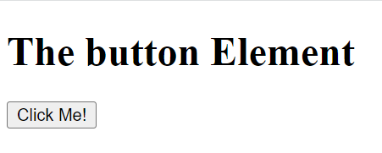
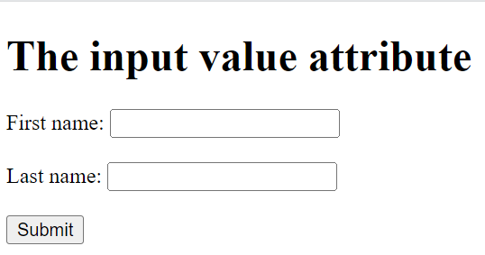
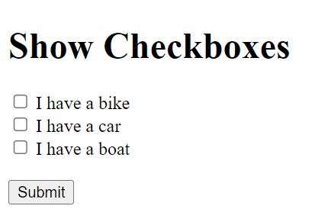
<!DOCTYPE html> <html> <body> <h1>The button Element</h1> <button type="button" onclick="alert('Hello world!')">Click Me!</button>
<form action="/action_page.php">
<label for="fname">First name:</label>
<input type="text" id="fname" name="fname" value="John"><br><br>
<label for="lname">Last name:</label>
<input type="text" id="lname" name="lname" value="Doe"><br><br>
<input type="submit" value="Submit">
</form>
<form action="/action_page.php">
<input type="checkbox" id="vehicle1" name="vehicle1" value="Bike">
<label for="vehicle1"> I have a bike</label><br>
<input type="checkbox" id="vehicle2" name="vehicle2" value="Car">
<label for="vehicle2"> I have a car</label><br>
<input type="checkbox" id="vehicle3" name="vehicle3" value="Boat">
<label for="vehicle3"> I have a boat</label><br><br>
<input type="submit" value="Submit">
</form>

Slide 16
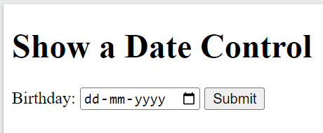
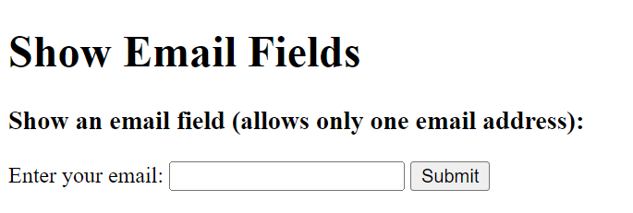
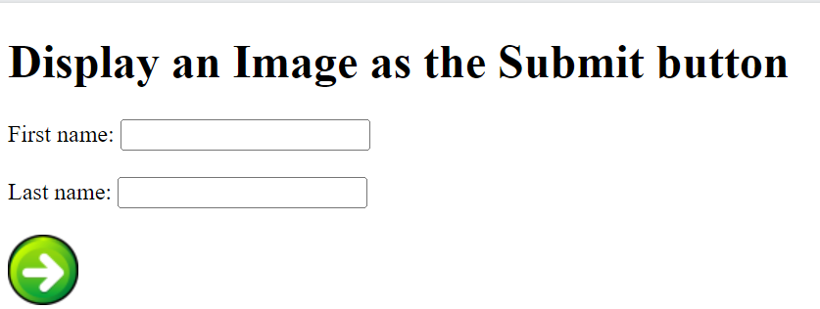
<h1>Show a Date Control</h1>
<form action="/action_page.php">
<label for="birthday">Birthday:</label>
<input type="date" id="birthday" name="birthday">
<input type="submit">
</form>
<h1>Show Email Fields</h1>
<h3>Show an email field (allows only one email address):</h3>
<form action="/action_page.php">
<label for="email">Enter your email:</label>
<input type="email" id="email" name="email">
<input type="submit">
</form>
<h1>Display an Image as the Submit button</h1>
<form action="/action_page.php">
<label for="fname">First name: </label>
<input type="text" id="fname" name="fname"><br><br>
<label for="lname">Last name: </label>
<input type="text" id="lname" name="lname"><br><br>
<input type="image" src="img_submit.gif" alt="Submit" width="48" height="48">
</form>

Slide 17
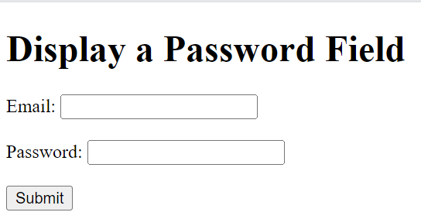
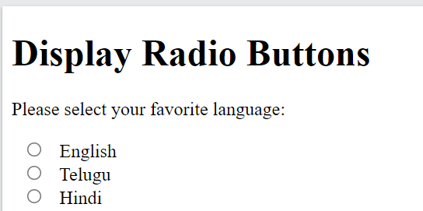
<h1>Display a Password Field</h1>
<form action="/action_page.php">
<label for="email">Email:</label>
<input type="email" id="email" name="email"><br><br>
<label for="pwd">Password:</label>
<input type="password" id="pwd" name="pwd" minlength="8"><br><br>
<input type="submit">
</form>
<h1>Display Radio Buttons</h1>
<form action="/action_page.php">
<p>Please select your favorite Web language:</p>
<input type="radio" id="html" name="fav_language" value="HTML">
<label for="html">HTML</label><br>
<input type="radio" id="css" name="fav_language" value="CSS">
<label for="css">CSS</label><br>
<input type="radio" id="javascript" name="fav_language" value="JavaScript">
<label for="javascript">JavaScript</label>

Slide 18
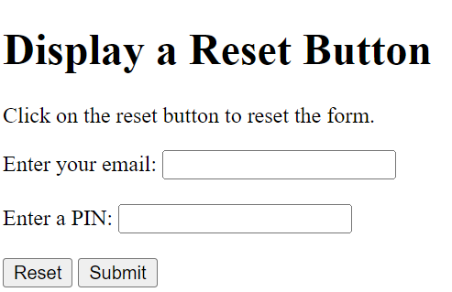
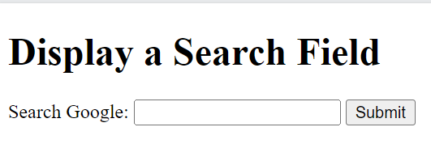
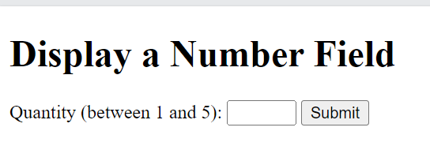
<h1>Display a Reset Button</h1>
<p>Click on the reset button to reset the form.</p>
<form action="/action_page.php">
<label for="email">Enter your email:</label>
<input type="email" id="email" name="email"><br><br>
<label for="pin">Enter a PIN:</label>
<input type="text" id="pin" name="pin" maxlength="4"><br><br>
<input type="reset" value="Reset">
<input type="submit" value="Submit">
</form>
<h1>Display a Search Field</h1>
<form action="/action_page.php">
<label for="gsearch">Search Google:</label>
<input type="search" id="gsearch" name="gsearch">
<input type="submit">
<h1>Display a Number Field</h1>
<form action="/action_page.php">
<label for="quantity">Quantity (between 1 and 5):</label>
<input type="number" id="quantity" name="quantity" min="1" max="5">
<input type="submit">
</form>
</form>
</body> </html>

Slide 19
Label Tag
<label for = “id ”> - - - - - </label>

Slide 20
Form Tag
<form> - - - - - - - - - - - - - - - </form>

Slide 21
Select Tag
<select>
<option value=“…”> XYZ </option>
- - - - - - - - - </select>

Slide 22
Comment
<!-- I ‘am comment buddy -->

Slide 23
Lists
Ordered list
<ol>
<li> - - - </li>
</ol>
Unordered list
<ul>
<li> - - - </li>
</ul>

Slide 24
Table
<table>
<tr>
<th> . . . </th> <th> . . . </th>
</tr>
<tr>
<td> . . . </td> <td> . . . </td>
</tr>
</table>

Slide 25
Anchor Tag
<a href = “...”> Text to be shown </a>

Slide 26
Image Tag
<img src=“.png” alt=“…” width=”xx" height=”xx">

Slide 27
Audio Tag
<audio controls>
<source src="XYZ.mp3" type="audio/mp3">
</audio>

Slide 28
Video Tag
<video width="320" height="240" controls>
<source src="XYZ.mp4" type="video/mp4">
</video>

Slide 29
Division or section
<div>
-----------
------------
</div>

Slide 30
Span
<span> ------------ </span>
<h1>The span element</h1>
<p>My mother has <span style="color:blue;font-weight:bold">blue</span> eyes and my father has <span style="color:darkolivegreen;font-weight:bold">dark green</span> eyes.</p>

Slide 31
CSS Cascading Style Sheet
Selector
{
Properties1: Value1;
Properties2: Value2;
Properties3: Value3;
}

Slide 32
Selector {“Prop:Volue;”}
Inline, Internal, external
<style>H1{ color:blue; } </style>
background-color:powderblue;
font: 15px Arial, sans-serif;
font: italic small-caps bold 12px/30px Georgia, serif;

Slide 33
Java Script (JS)

Slide 34
Questions?

Slide 35
Thank You!

